Slide 1
Easy and Inexpensive Remote Operating with FT8

Slide 2
You Can Do It!
Not about what I did, but what you CAN DO.
If you can run FT8, you can do it REMOTELY
You can probably do it without additional cost.

Slide 3
What You Need
An FT8 capable station
We can help you set one up if you haven’t already
A device to operate remotely
Laptop, tablet, phone etc.
Software to connect to your shack computer
Teamviewer

Slide 4
Teamviewer
Teamviewer.com
Free for personal use
Secure
Download for your shack computer
Download for your device

Slide 5
Teamviewer.com

Slide 6
Shack Computer

Slide 7
Shack Computer

Slide 8
Configuration Continued

Slide 9
Install Teamviewer on your “Remote Device”
Phone/Tablet – App store/ Google Play store
Laptop – Download Teamviewer
Need your ID number and the password you set up to connect to your shack computer

Slide 10
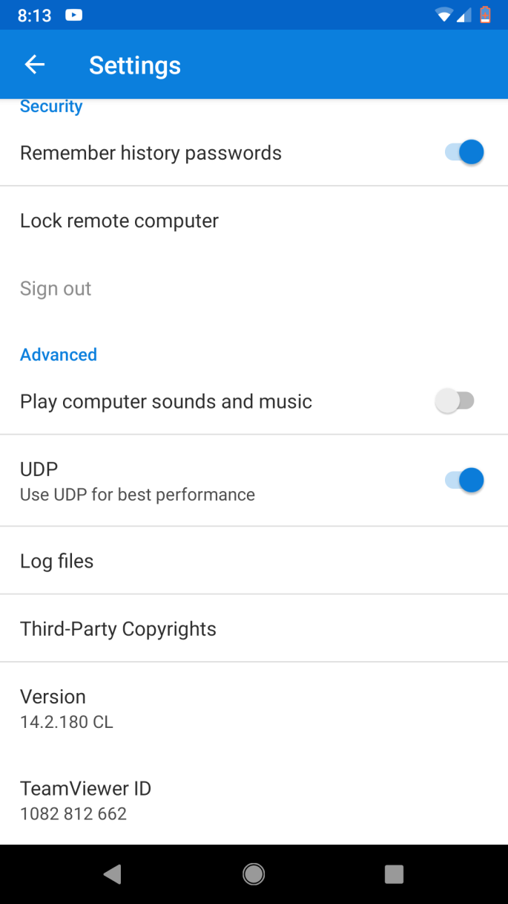
Remote Device Configuration
Turn off “Play computer sounds and music” unless you want to annoy everyone with FT8
You can save your password for convenience

Slide 11
All you need to get started
Turn your computer/rig on and set up for FT8
Connect with your remote device and get on the air.

Slide 12
Ever DX while Mowing the Lawn?
90% of my “remote” operating is from my QTH.
Surprising amount of QSO’s can be made with a spare moment or commercial break during family movie night
I don’t have to worry about the “remote” station

Slide 13
Possible Enhancements
Multi-band antenna
I use a 40M OCFD
RF sensing antenna tuner (if required)
LDG or MFJ
Remote power on off?
Remote antenna disconnect?

Slide 14
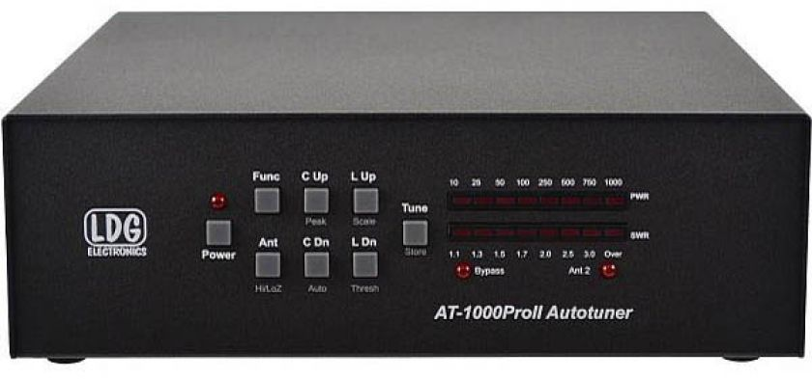
“Kilowatt” Antenna Tuner
Power rating HF (1.8 to 30 MHz):1000 Watts Single Side Band
750 Watts CW
400 Watts Digital (RTTY, Packet, etc)

Slide 15
My Takeaways
It’s great to be on the air more.
Operating remotely makes sitting down at the rig all the more enjoyable.
I can take the time to enjoy CW and SSB more, instead of just being satisfied with time on the air
Learning propagation on a band – can be listen only

